Slide 1

Six Degrees of Sql Family? An introduction to Graph Databases in SQL Server (and CosmosDB)
Patrick Flynn | Link Group Australia

Slide 2

Who Am I
Patrick Flynn
Twitter @sqllensman
email sqllensman@outlook.com
Happy to answers any queries on this or any other SQL Server issues
MCM – SQL Server 2008
MCSM – Data Platform
Production DBA for 10+ years.

Slide 3



Thanks to all our Sponsors

Slide 4
Agenda
Graph’s and Graph Database’s
Why are they useful?
What problems do they solve?
Implemention in SQL Server
Implemention in Cosmos DB (very short!)

Slide 5
What is a Graph ?

Slide 6
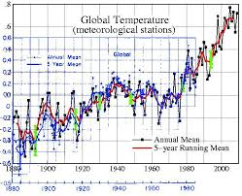
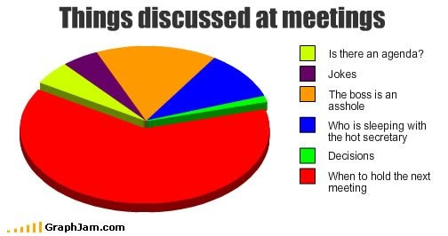
This session is NOT about
Notes:
What is not Graph Data
If you are here hoping to learn how to make pretty pictures of your data then I’m afraid this is not what we are talking about today.

Slide 7
It is also NOT about
Microsoft Graph
“Use the Microsoft Graph API to connect to the data that drives productivity – mail, calendar, contacts, documents, directory, devices, and more.”
GraphQL
“GraphQL is a query language for your API, and a server-side runtime for executing queries by using a type system you define for your data. GraphQL isn't tied to any specific database or storage engine and is instead backed by your existing code and data”

Slide 8
Graph Theory

Slide 9
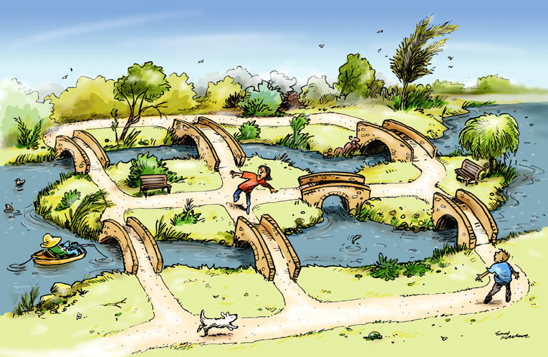
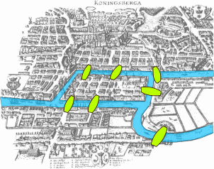
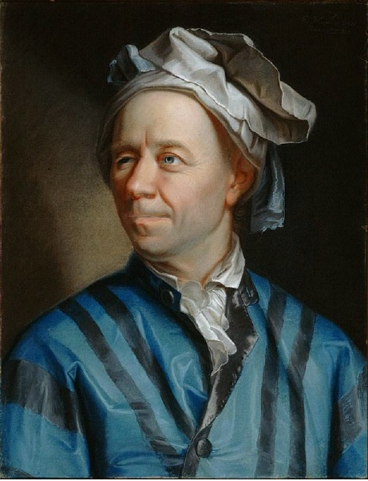
Origin: The Königsberg Bridge Problem
Leonhard Euler (1707–1783)
Can you take a walk through the town, visiting each part of the town and crossing each bridge only once?
Notes:
The Königsberg Bridge Problem
Our story begins in the 18th century, in the town of Königsberg, Prussia on the banks of the Pregel River
The city built seven bridges across the river dividing the city into four distinct regions
The citizens of Königsberg used to spend Sunday afternoons walking around the city.
They devised a game for themselves, their aim was to find a way in which they could walk around the city, crossing each of the seven bridges only once.
Even though none of the citizens of Königsberg could find a route that would allow them to cross each of the bridges only once, no one could prove, mathematically, that it was impossible.
The famous mathematician, Leonhard Euler, was asked to find a solution and although initially uninterested eventually became intrigued by it.
In 1731 Euler published a paper that solved the problem and, at the same time, gave birth to the subject of graph theory.
On August 26, 1735, Euler presented a paper that addressed both this specific problem, as well as a general solution with any number of landmasses and any number of bridges.
This paper, called ‘Solutio problematis ad geometriam situs pertinentis,’ (The solution of a problem relating to the geometry of position) was later published in 1741

Slide 10
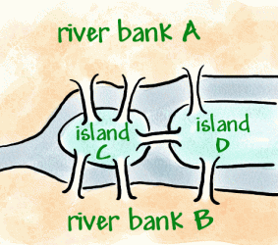
Solving the Königsberg Bridge Problem
A
3
1
2
C
7
D
4
5
6
B
Notes:
The Königsberg Bridge Problem
Euler simplified the problem
We effectively have four land masses (A, B, C and D)
And seven bridges connecting those land masses (1-7).
He turned the land masses into single points (which he called nodes)
and the bridges as lines connecting the nodes (which he called edges or vertices)
// Euler had put the essential features of Königsberg into a graph.

Slide 11
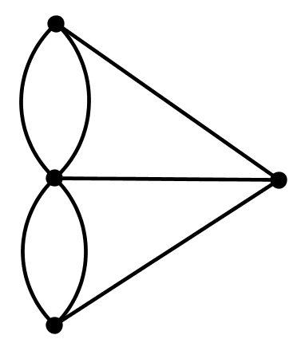
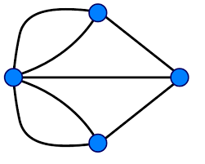
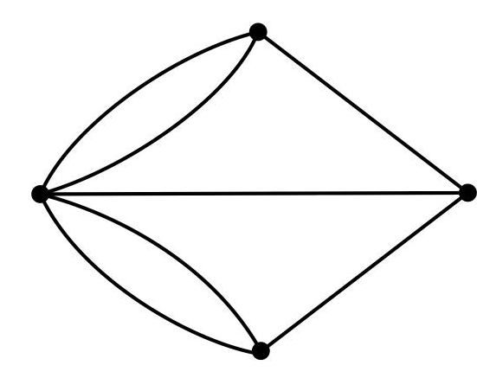
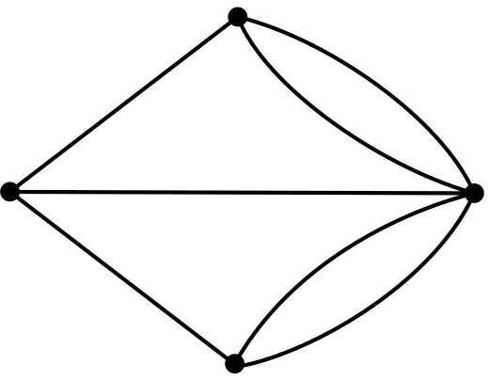
Solving the Königsberg Bridge Problem
A
C
D
B
Notes:
The Königsberg Bridge Problem
Let’s remove the picture and what we end up with, in mathematical terms, is a graph. We can draw this in whatever shape we like but it is still the same graph
We can restate our challenge like this:
Starting at any of the four nodes A, B, C or D, find a path through the graph such that you travel across each edge exactly once.
In simple terms, what Euler found was:
The graph is traversable if:
If all nodes are even (there are zero odd nodes)
Or
exactly two nodes are odd and the remaining nodes are even
In Königsberg all four nodes have an odd number of edges. Therefore we don’t meet the requirements so there is no Eulerian path.
In graph theory, an Eulerian trail (or Eulerian path) is a trail in a finite graph which visits every edge exactly once.
Similarly, an Eulerian circuit or Eulerian cycle is an Eulerian trail which starts and ends on the same node
A more long winded explanation
What Euler found was:
If a node has an even number of edges, then if you start at that node (and you traverse each edge exactly once), then you must also end your route at that same node.
But,
If a node has an odd number of edges, then if you start at that node (and you traverse each node exactly once) then you must end your route at some other node.
If a node has an even number of edges, then if you start at that node (and you traverse each edge exactly once), then you must also end your route at that same node.
But,
If a node has an odd number of edges, then if you start at that node (and you traverse each node exactly once) then you must end your route at some other node.
Start your walk at node A. Now move to node C. Node C has five edges, however, you’ve already used one of them (you might think about this as literally “burning your bridges” every time you cross an edge), so it’s as if you’re now starting at a node with an even number of edges.
We know from the previous paragraph that means your route must end at node C.
Now move to node D, which also has an odd number of edges. Again you’ve used up one edges and you’re left with an even number of edges at node D, which implies your route must also end at node D.
But we’ve just established that your route must end at node C so we have a contradiction, Thus, given your starting path (A->C->D), no route meeting the required conditions is possible.
Therefore, it doesn’t really matter where you start – the second node you visit is going to have an even number of edges left after you arrive there and, therefore, we must end our route on that second node. But the same thing will be true of the third node we visit. So, regardless of the path we take through our first three nodes, we’re going to conclude that our path must end at our second AND third nodes. No route could end in two places so we’ve effectively proven, by contradiction, that no possible route can be found which satisfies our conditions.

Slide 12
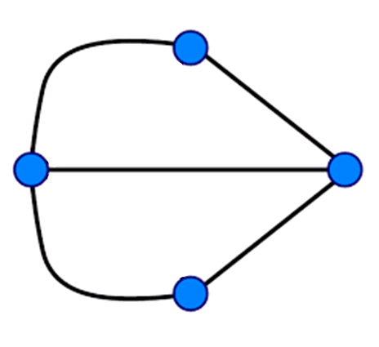
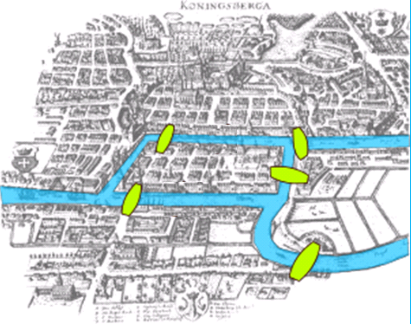
Kaliningrad Today
A
C
D
B
Notes:
Kaliningrad Today
Two of the seven original bridges did not survive World War II.
And Königsberg is now part of Russia called Kaliningrad.
So there are now only five bridges in Kaliningrad.
If we represent the town as a graph we get:
Node A has 2 degrees
Node B has 2 degrees
Node C has 3 degrees
Node D has 3 degrees
In terms of graph theory, we have two even and just two odd nodes
Therefore, an Eulerian path is now possible, but it must begin on one island and end on the other

Slide 13
Graph Theory: Directed Graph
Definition
In formal terms, a directed graph is an ordered pair G = (V, A) where
V is a set whose elements are called vertices, nodes, or points;
A is a set of ordered pairs of vertices, called arrows, directed edges (sometimes simply edges with the corresponding set named E instead of A), directed arcs, or directed lines.
Notes:
Warning:

Slide 14
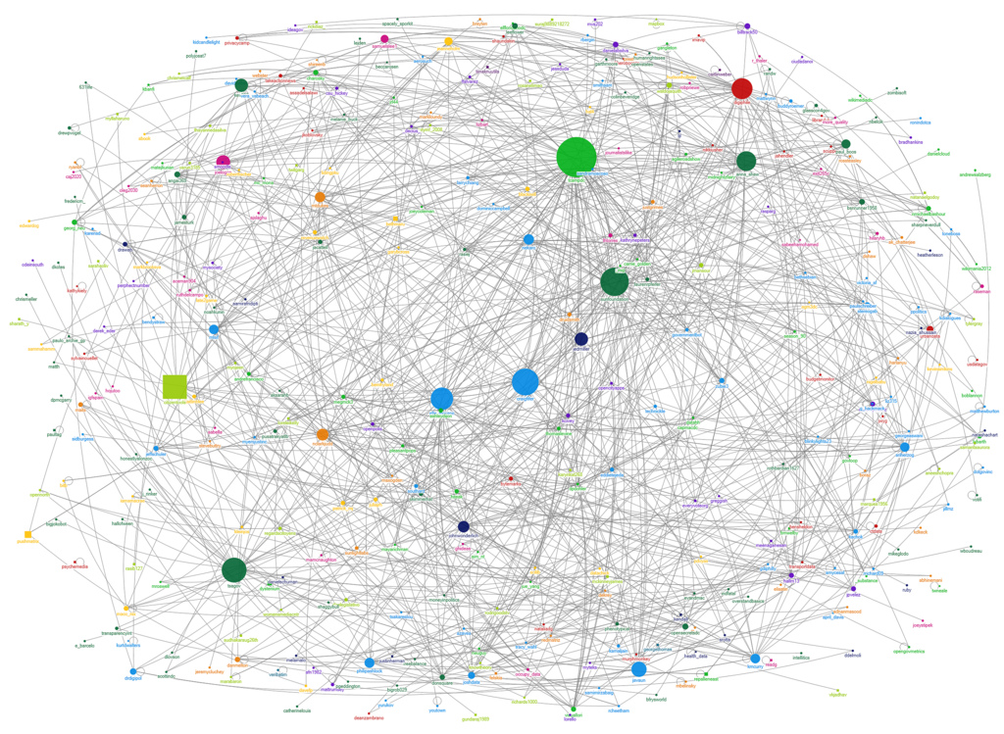
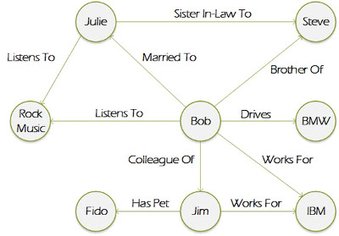
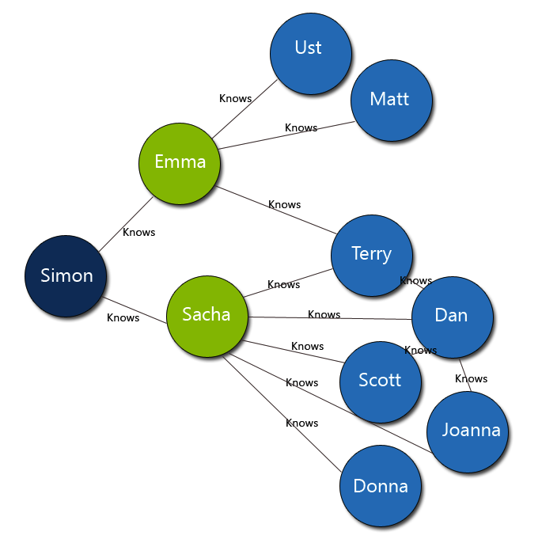
What is Graph Data?
Notes:
What is Graph Data?
What we will be looking at is graphs that look like this where we have a collection of related data known as nodes and relationships between them known as edges.
Graph databases like this have become very popular in the last few years in areas such as supply chain management and sales data analysis.
The recommendation engines that you see on places like Amazon and eBay where it tells you that someone who bought this product also bought this other product are using graph databases.
Facebook and LinkedIn use a graph database to tell you who your 1st, 2nd or 3rd degree friends.
In fact anything where there is connected data can benefit from using a graph database.
And this is what we are looking at today.

Slide 15
So, what is a Graph Database?
A Graph Database is a Database that is modelled as a Graph
Data as it appears in the real world is naturally connected.
Traditional data modeling focuses on entities.
For many applications, there's also a need to model both entities and relationships naturally.
A graph database is a structure that's composed of vertices and edges.

Slide 16
What is a Graph Database
Vertices denote discrete objects, such as a person, a place, or an event.
Edges denote relationships between vertices.
For example,
a person might know another person, be involved in an event, and recently been at a location.

Slide 17
What is a Graph Database
Both vertices and edges can have an arbitrary number of properties.
Properties express information about the vertices and edges.
Example properties include
a vertex that has a name, age, weight
an edge, which has a time stamp or description.

Slide 18
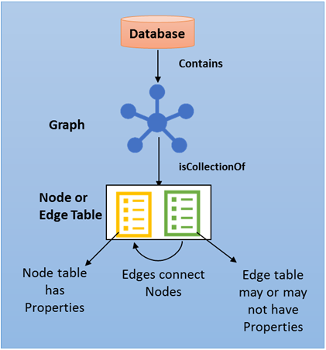
What is a Graph Database
Both vertices and edges can have an arbitrary number of properties.
Properties express information about the vertices and edges.
Example properties include
a vertex that has a name, age, weight
an edge, which has a time stamp or description.

Slide 19
What is a Graph Database
Edges and relationships are first class entities and can have attributes or properties
A single edge can flexibly connect multiple nodes
Easily express pattern matching and multi-hop navigation queries
Supports OLTP and OLAP (analytics) just like SQL databases

Slide 20
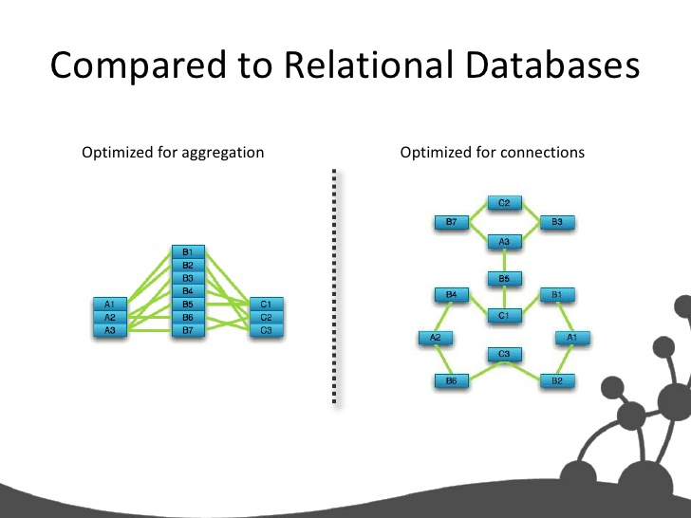

Slide 21
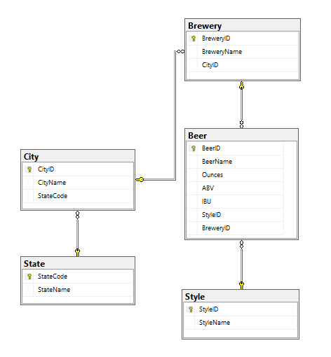

Slide 22
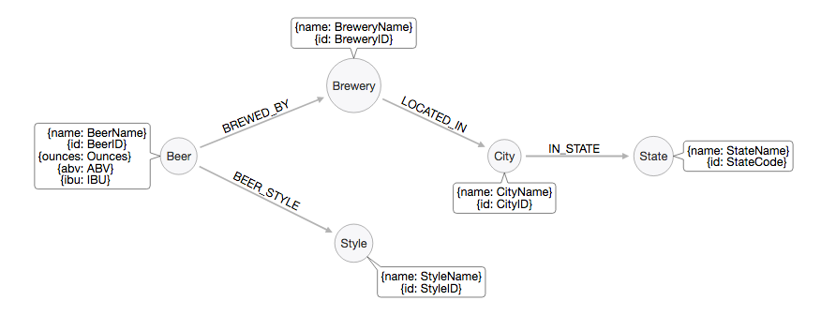

Slide 23
Uses for a Graph Database

Slide 24
Uses for a Graph Database
Common Graph Database Scenarios
Recommendation Systems
Fraud Detection
Content Management
Bill of Materials, product hierarchy
CRM

Slide 25
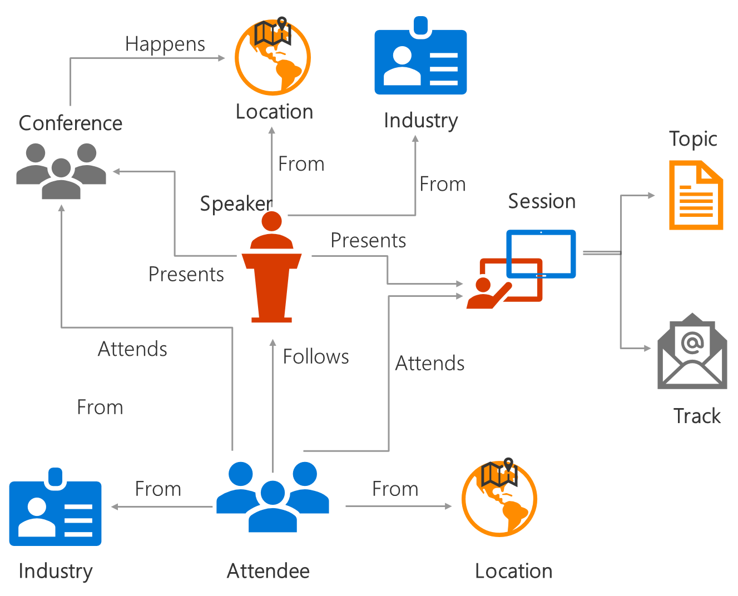
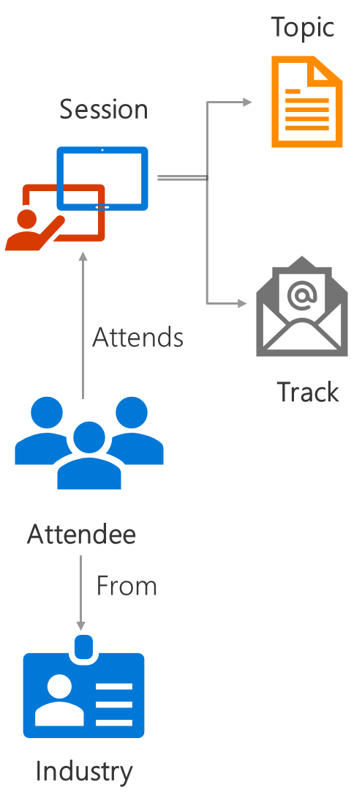
Uses for a Graph Database
John
Mary
Alice
Shaun
Jacob
Jerry
Bob
Natalie
Hierarchical or interconnected data, entities with multiple parents.
Analyze interconnected data, materialize new information from existing facts. Identify non-obvious connections
A
manages
leads
leads
leads
Complex many-to-many relationships. One relation flexibly connecting multiple entities.

Slide 26
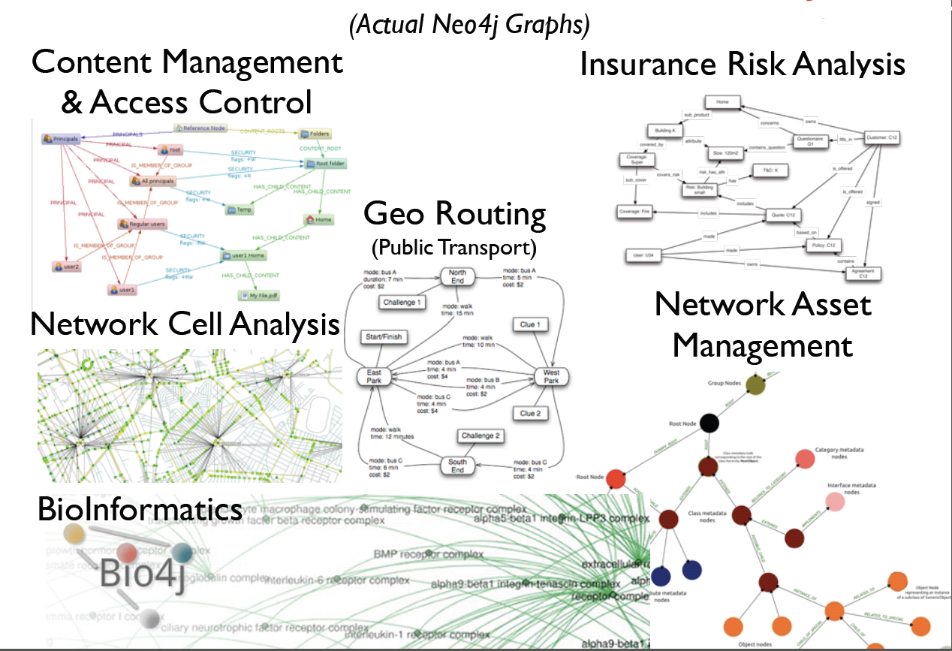
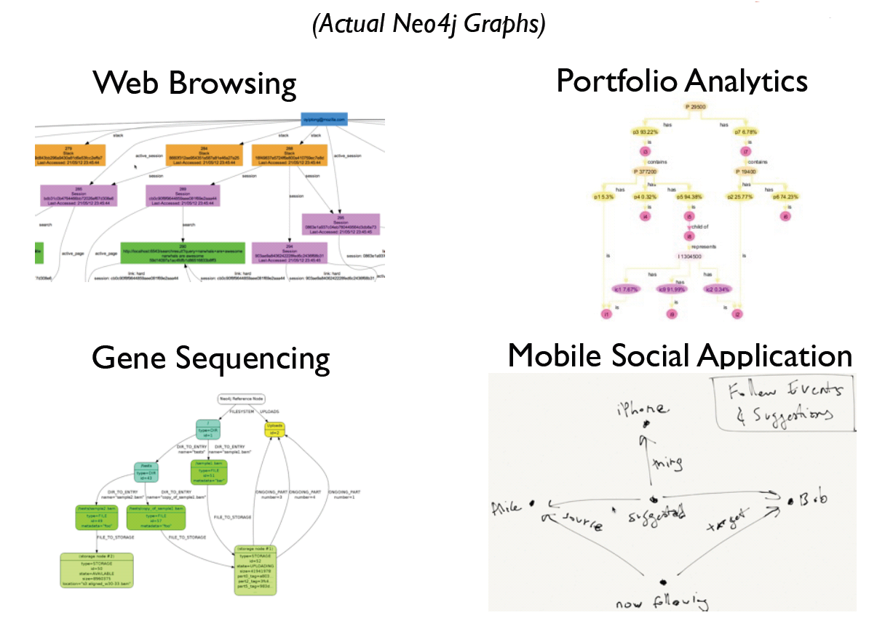
Uses for Graph Databases
https://neo4j.com/blog/analyzing-panama-papers-neo4j/
Notes:
Uses for Graph Databases
As I’ve already said graph databases have a wide variety of uses and as people discover graph and find that it is easier to traverse and query a graph than a traditional relational databases the usage is growing.
These images are taken from Neo4j and show some of the ways that their graph is being used
Content management
Insurance Risk Analysis
Public Transport
BioInformatics
Network Asset Management
Fraud detection
Real-time recommendation engines
Master data management (MDM)
Network and IT operations
Most dating sites now use graph databases.
As do most job websites
Twitter created its own graph database, which it has released as FlockDB as open source.
Neo Technology claims to have more than 30 Global 2000 companies using its technology, including enterprise brands like Wal-Mart, eBay, Lufthansa, and Deutsche Telekom.
The data from the Panama papers, that exposed the financial shenanigans of the rich and powerful was placed into a graph database for analysis.
This allowed the investigators to see connections between related people, their different addresses, shared directorships and the like and see through the fog that many of these people use to try hide what they are doing.
You can see how it was done at https://neo4j.com/blog/analyzing-panama-papers-neo4j/

Slide 27
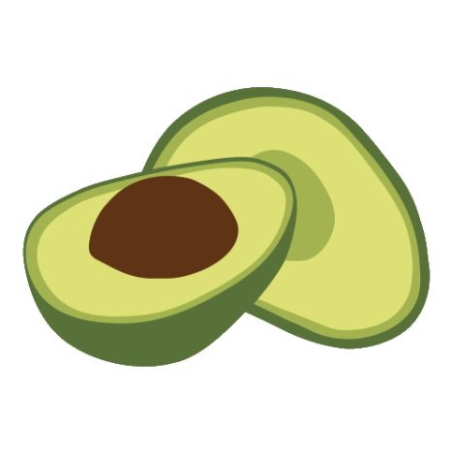

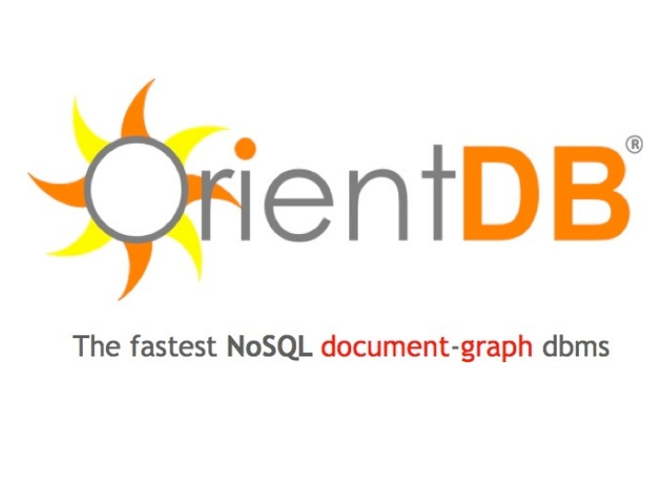



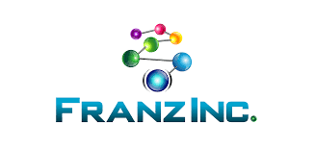

Major Vendors in Graph Database
Neo4j
Orient DB
ArangoDB
Titan
mongoDB
Complexible Stardog
Franz AllegroGraph
Oracle
Notes:
Major Vendors
Microsoft are quite late to the graph database scene
The Graph database is mature market with lots of vendors offering graph database software. Nearly all use open source NoSQL databases
I’ve listed what seem to the most common here
Neo4j by Neo Technologies is definitely the most popular with plenty of videos and articles on graph database. Many of the images and information used in this presentation have come from their web site.
A full list can be found here: https://www.g2crowd.com/categories/graph-databases?utf8=%E2%9C%93&order=top_shelf

Slide 28
When to use a Graph Database
Some potential deciding factors
Application has hierarchical data
While the HierarchyID datatype can be used to implement hierarchies, it has limitations (eg it does not allow multiple parents for a node)
Application has complex many-to-many relationships and as application evolves, new relationships are added.
You need to analyze interconnected data and relationships

Slide 29
SQL Server Implementation

Slide 30
Fully integrated in SQL Server Engine
Graph extensions are fully integrated in SQL Server engine
Same storage engine, metadata, query processor to store & query data
Query across graph & relational data in a single query
Combine capabilities with technologies like columnstore, HA, R services
Supports all standard security & compliance features

Slide 31
Creating Graph Objects

Slide 32
Create Graph Object
Objects are created with Transact-SQL extensions
Nodes and edges are stored as tables
All operations supported on relational tables are supported on node or edge tables
Both nodes and edges can have properties associated to them

Slide 33
Create Graph Object
CREATE TABLE Person ( ID INTEGER PRIMARY KEY, Name VARCHAR(100), Age INT ) AS NODE;
CREATE TABLE Friends ( StartDate date ) AS EDGE;

Slide 34
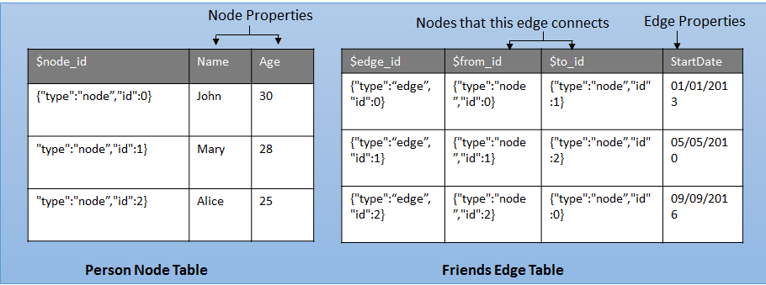
Create Graph Object
CREATE TABLE Person ( ID INTEGER PRIMARY KEY, Name VARCHAR(100), Age INT ) AS NODE;
CREATE TABLE Friends ( StartDate date ) AS EDGE;

Slide 35
Node Table
A node table represents an entity in a graph schema
When a node table is created, along with user defined columns, an implicit $node_id column is created, which uniquely identifies a given node in the database
The values in $node_id are automatically generated and are a combination of object_id of that node table and an internally generated bigint value.

Slide 36
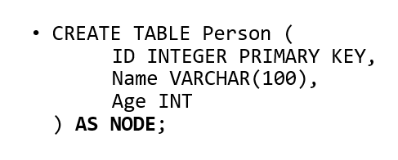
Node Table
A node table represents an entity in a graph schema
When a node table is created, along with user defined columns, an implicit $node_id column is created, which uniquely identifies a given node in the database
The values in $node_id are automatically generated and are a combination of object_id of that node table and an internally generated bigint value.

Slide 37
Node Table
$node_id is a pseudo column, that maps to an internal name with hex string in it. When you select $node_id from the table, the column name will appear as $node_id_\<hex_string>
If you do not create a unique constraint or index on the $node_id column at the time of creation of node table, a default unique, non-clustered index is automatically created

Slide 38
Edge Table
An edge table represents a relationship in a graph
Edges are always directed and connect two nodes
An edge table may or may not have any user defined attributes in it

Slide 39
Populating Content

Slide 40
Populating Content - Nodes
Same syntax as a normal insert
-- Insert into node table
INSERT INTO dbo.Person VALUES (1, 'Alice');
INSERT INTO dbo.Person VALUES (2, 'John');
INSERT INTO dbo.Person VALUES (3, 'Jacob');

Slide 41
Populating Content – Edges
Standard Insert statement using subqueries to retrieve the $node_id values to use as source and destination values.
-- Insert into edge table
INSERT INTO dbo.friend VALUES ( (SELECT $node_id FROM dbo.Person WHERE name = 'Alice’), (SELECT $node_id FROM dbo.Person WHERE name = 'John’), '9/15/2011’ );

Slide 42
Populating Content - Edges
Standard Insert statement using subqueries to retrieve the $node_id values to use as source and destination values.
-- Insert into edge table
INSERT INTO dbo.friend VALUES ( (SELECT $node_id FROM dbo.Person WHERE name = 'Alice’), (SELECT $node_id FROM dbo.Person WHERE name = 'John’), '9/15/2011’ );

Slide 43
SQL language extensions

Slide 44
Query language extensions
New MATCH clause is introduced to support pattern matching and multi-hop navigation through the graph
The MATCH function uses ASCII-art style syntax for pattern matching
-- Find friends of John
SELECT Person2.Name
FROM Person Person1, Friends, Person Person2
WHERE MATCH(Person1-(Friends)->Person2)
AND Person1.Name = 'John';

Slide 45
Cypher Query Language
Almost CQL but not quite
MATCH (<graph_search_pattern>)
<graph_search_pattern>::=
{<node_alias> {
{ <-( <edge_alias> )- }
| { -( <edge_alias> )-> }
<node_alias>
}
}
[ { AND } { ( <graph_search_pattern> ) } ]
[ ,...n ]
--Find all tournaments that Roger played at
SELECT [Tournament],[year]
FROM NPlayers, PlayedAt, Ntournaments
WHERE MATCH (NPlayers-(PlayedAt)->Ntournaments)
AND NPlayers.player_Name like '%Federer%'
GO
Notes:
Almost CQL
The new command in SQL comes from Cypher Query Language or CQL
CQL was originally developed by for Neo4j. In 2015 it was made open source. (CosmosDB Graph implementation based on TinkerPop)
The command that SQL has adopted is the MATCH clause that identifies what data needs to be matched with
// In SQL Server the MATCH filter is an extension of the WHERE clause, but in “proper” CQL it is a simple matching criteria that would precede the WHERE clause

Slide 46
System Functions
OBJECT_ID_FROM_NODE_ID
Extract the object_id from a node_id
GRAPH_ID_FROM_NODE_ID
Extract the graph_id from a node_id
NODE_ID_FROM_PARTS
Construct a node_id from an object_id and a graph_id
OBJECT_ID_FROM_EDGE_ID
Extract object_id from edge_id
GRAPH_ID_FROM_EDGE_ID
Extract identity from edge_id
EDGE_ID_FROM_PARTS
Construct edge_id from object_id and identity

Slide 47
Examples

Slide 48
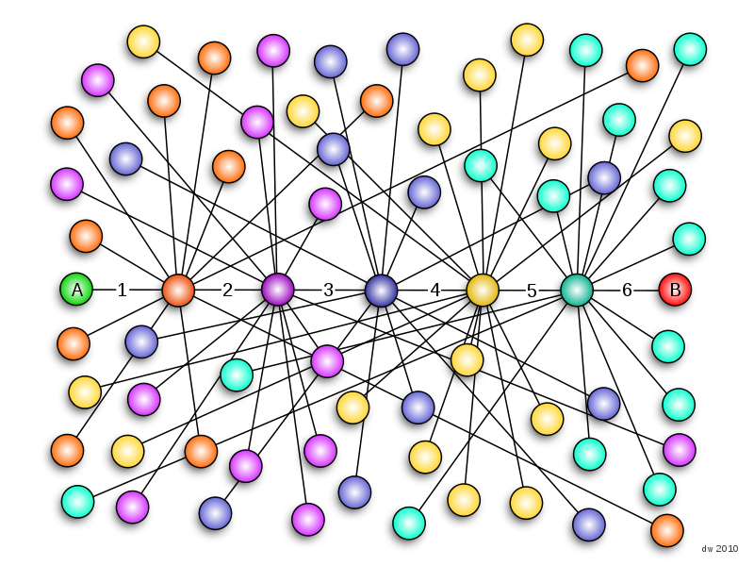
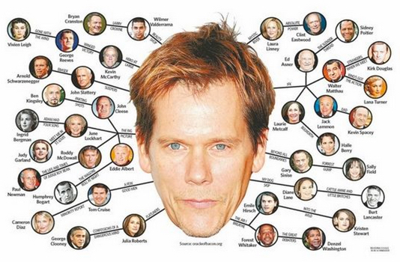

The Kevin Bacon Problem
The Theory of Six Degrees of Separation
Notes:
Six Degrees of Kevin Bacon
This bring us to the most important question of all
Six Degrees of Kevin Bacon is a parlour game based on the "six degrees of separation" concept, which hypothesizes that any two people on Earth are six or fewer acquaintance links apart.
In January 1994 Kevin Bacon said that he had worked with everyone in Hollywood or someone has worked with them
Now movie buffs challenge each other to find the shortest path between an arbitrary actor and Kevin Bacon.
It rests on the assumption that anyone involved in the Hollywood film industry can be linked through their film roles to Bacon within six steps.
The game requires a group of players to try to connect any such individual to Kevin Bacon as quickly as possible and in as few links as possible.
Maybe for SQL community we could change it to the Brent Ozar paradox !
From Wikipedia
In a January 1994 Premiere magazine interview about the film The River Wild, Kevin Bacon commented that he had worked with everybody in Hollywood or someone who's worked with them.
On April 7, 1994, a lengthy newsgroup thread headed "Kevin Bacon is the Center of the Universe" appeared.
The game was created in early 1994 by three Albright College students, Craig Fass, Brian Turtle, and Mike Ginelli. According to an interview with the three in the spring 1999 issue of the college's magazine, The Albright Reporter, they were watching Footloose during a heavy snowstorm. When the film was followed by The Air Up There, they began to speculate on how many movies Bacon had been in and the number of people he had worked with. In the interview, Brian Turtle said, "It became one of our stupid party tricks I guess. People would throw names at us and we'd connect them to Kevin Bacon."
The trio wrote a letter to talk show host Jon Stewart, telling him that "Kevin Bacon was the center of the entertainment universe" and explaining the game. They appeared on The Jon Stewart Show and The Howard Stern Show with Bacon to explain the game. Bacon admitted that he initially disliked the game because he believed it was ridiculing him, but he eventually came to enjoy it. The three inventors released a book, Six Degrees of Kevin Bacon (ISBN 9780452278448), with an introduction written by Bacon. A board game based on the concept was released by Endless Games.
In 2007, Bacon started a charitable organization called SixDegrees.org.
Six degrees of separation is the idea that all living things and everything else in the world are six or fewer steps away from each other so that a chain of "a friend of a friend" statements can be made to connect any two people in a maximum of six steps.

Slide 49
SQL Saturday Conferences
Attendee
knows
Speaker
attended
Presented at
Event
presented
delivered at
Session
Notes:
Architectural Notes
Nodes and Edges are nothing more than tables with some special fields. There’s no restriction that forbids us to create regular relationships between these tables, turning the model into a mix of relational and graph model.
For example, the relationship ‘Written By’ between ‘Posts’ and ‘Members’ is a simple one-to-many relationship. Instead of using an edge table, we could express it with a regular relation between these tables, creating a mixed model.

Slide 50
Limitations

Slide 51
Limitations
Missing Important Graph Database functions:
Transitive Closure
Polymorphism
Functions such as Shortest Path or Arbitrary Length travesal
Notes:
Limitations
This release of SQL graph is definitely not ready for production systems. It lacks a number of very important features. It should be considered a version 0.1.
I guess Microsoft have added it to show customers that they are serious about graph processing to encourage people who might be considering other vendors, such as Neo4j to hang on
Transitive Closure - How do I find a node connected to me, an arbitrary number of hops away, in my graph?
The ability to recurse through a combination of nodes and edges, an arbitrary number of times, is called transitive closure.
e.g. Find all the people connected to me through three levels of indirections or find the employee chain for a given employee in an organization.
Transitive closure is not supported in the first release. A recursive CTE or a T-SQL loop may be used to work around these types of queries.
Polymorphism - How do I find ANY Node connected to me in my graph?
The ability to find any type of node connected to a given node in a graph is called polymorphism.
SQL graph does not support polymorphism in the first release.
A possible workaround is to write queries with UNION clause over a known set of node and edge types. However, this workaround is good for a small set of node and edge types.
Functions - Are there special graph analytics functions introduced?
Some graph databases provide dedicated graph analytical functions like “shortest path” or “page rank.”
SQL Graph does not provide any such functions in this release. Again, T-SQL loops and temp tables may be used to write a workaround for these scenarios.
Not Supported
Is the new MATCH syntax supported on relational tables?
No. MATCH clause works only on graph node and edge tables.
Can I alter an existing table into a node or edge table?
No. In the first release, ALTER TABLE to convert an existing relational table into a node or edge table is not supported.
Users can create a node table and use INSERT INTO … SELECT FROM to populate data into the node table.
To populate an edge table from an existing table, proper $from_id and $to_id values must be obtained from the node tables.
What are some table operations that are not supported on node or edge tables?
In the first release, node or edge tables cannot be created as memory-optimized, system-versioned, or temporary tables.
Stretching or creating a node or edge table as external table (PolyBase) is also not supported in this release.
Can’t Update
Can’t currently update edge IDs in edge records so if any changes you need to make then you will have to delete the record and re create it.
Referential Integrity
You can delete records from nodes even if there are records I the related edge tables

Slide 52
Limitations
Local or global temporary tables cannot be node or edge tables
Table types and table variables cannot be declared as a node or edge table
Node and edge tables cannot be created as system-versioned temporal tables
Node and edge tables cannot be memory optimized tables
Cross database queries on graph objects are not supported

Slide 53
Limitations
Directionality of an edge matters. It’s something you have to pay attention to.
Cannot update the $from_id and $to_id columns of an edge using UPDATE statement
Have to insert a new edge pointing to new nodes and delete the previous one
It is not possible to define constraints on the edge table, to restrict it from connecting any two type of nodes.
An edge can connect any two nodes in the graph, regardless of their types.

Slide 54
Azure CosmosDB
Globally distributed, multimodel database service
Graph processing via Azure Cosmos DB Graph API
Uses the Apache TinkerPop graph traversal language, Gremlin
Provides Graph modelling and Traversal APIs

Slide 55
Social
Make sure you tweet on #SQLSat725 or #SQLSatVictoria
Don’t forget to thank Sponsors, Volunteers and Speakers!

Slide 56


Questions?
?
?
?
?
?
?
?
?
@sqllensman
Patrick Flynn
?
?
?
?
?
?
?
?

Slide 57
Thank You

Slide 58
SQL Server Graph Resources
Documentation
https://docs.microsoft.com/en-us/sql/relational-databases/graphs/sql-graph-overview
https://blogs.technet.microsoft.com/dataplatforminsider/2017/04/20/graph-data-processing-with-sql-server-2017/
Microsoft Video’s
https://channel9.msdn.com/Events/Connect/2017/T146
https://www.youtube.com/watch?v=csQyffwg9Ww
PASS Application Development VC
https://www.youtube.com/watch?v=SdKwDhe5J4M&feature=youtu.be
YouTube
https://www.youtube.com/watch?v=SdKwDhe5J4M&feature=youtu.be
http://blogs.adatis.co.uk/terrymccann/post/SQL-Server-2017-Graph-data-processing-An-introduction

Slide 59
Azure Cosmos DB Graph Links
https://docs.microsoft.com/en-us/azure/cosmos-db/graph-introduction
https://docs.microsoft.com/en-us/azure/cosmos-db/gremlin-support
https://docs.microsoft.com/en-us/azure/cosmos-db/create-graph-gremlin-console
https://aka.ms/CosmosDBlearn

